Slide 1
Checkers
International Women's Day Hackathon 2015
Developed By..
Vinnie Da Silva
Pratima L. Gauns

Slide 2
Concept
While playing an interesting real world board game with your best buddy, what would you do if you are called by some urgent work? Unfortunately, you’ll have to leave the game in the middle and run away.
What if you could capture the game’s state on a device easily and resume the play on the device after some time.
That’s the concept we tried demonstrating through our app using a Checker Board game.

Slide 3
Requirements
Device – iPad Application. Tested on iPad 3 and iPad 4
OS – iOS 8 and above.
Orientation – Portrait mode

Slide 4
Screens
Screen 1- Image Capture Screen
Allows you to capture an image. Adjust the iPad camera to correctly fit the displayed frame with your game board. Once done tap the screen to capture.
We detect the board edges and show the preview of the captured image. User can either select the image and tap on “Next” or opt to recapture using “Reset”.
The “Select Demo Picture” allows to select a static picture for demo purpose in case game board is not available for capturing image.

Slide 5
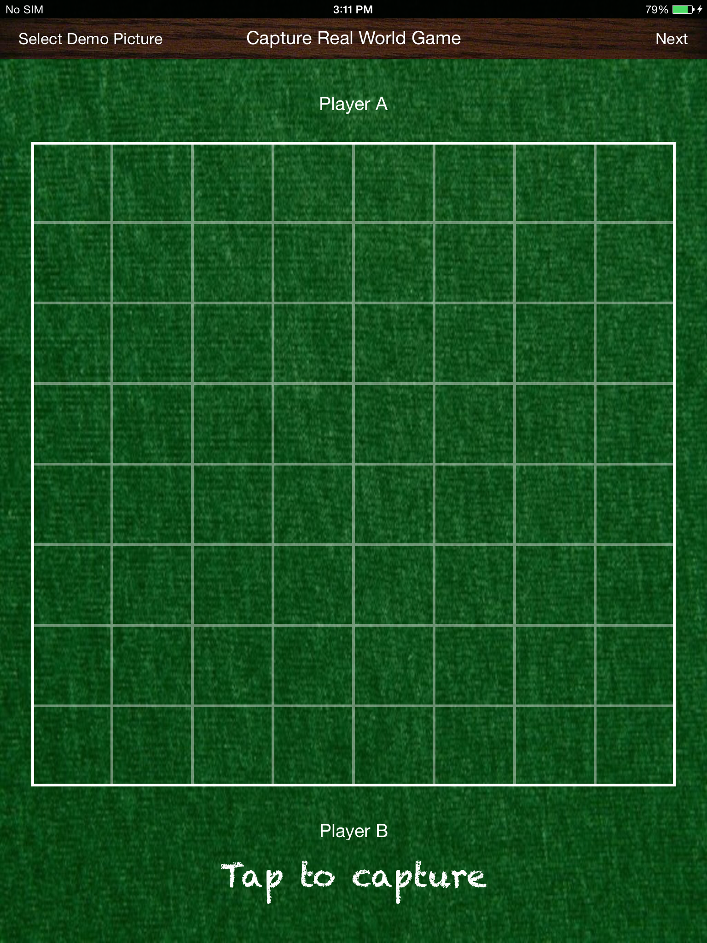

Slide 6
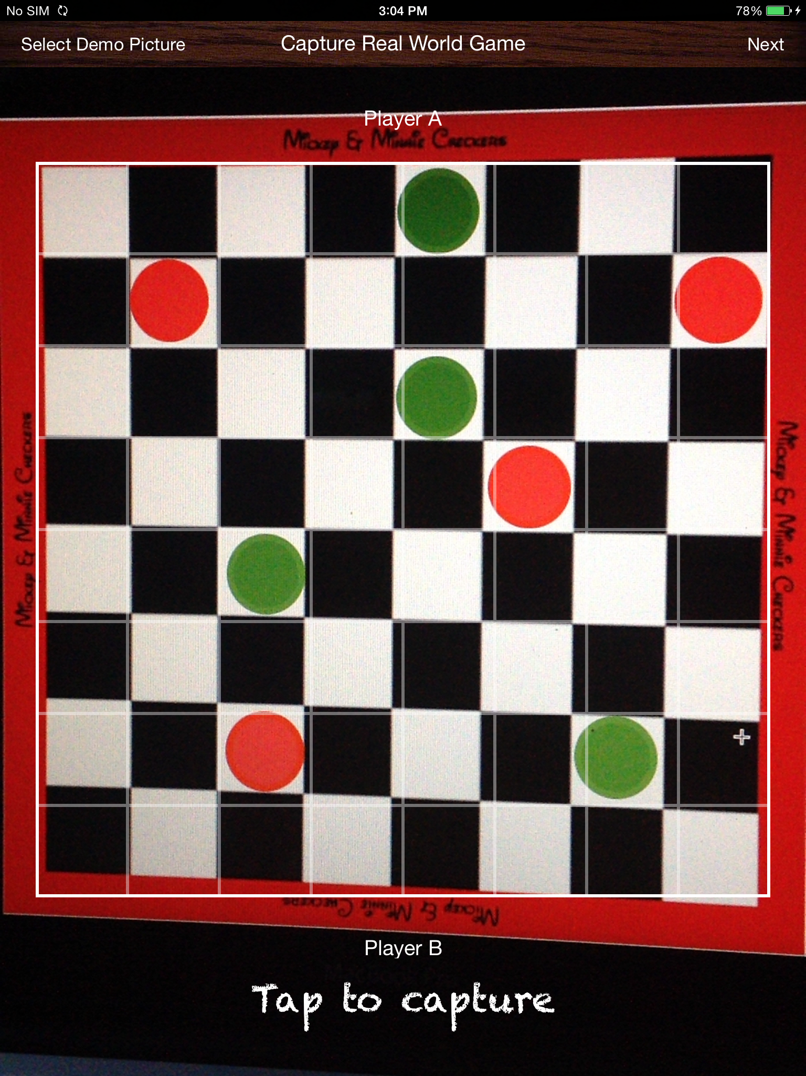

Slide 7
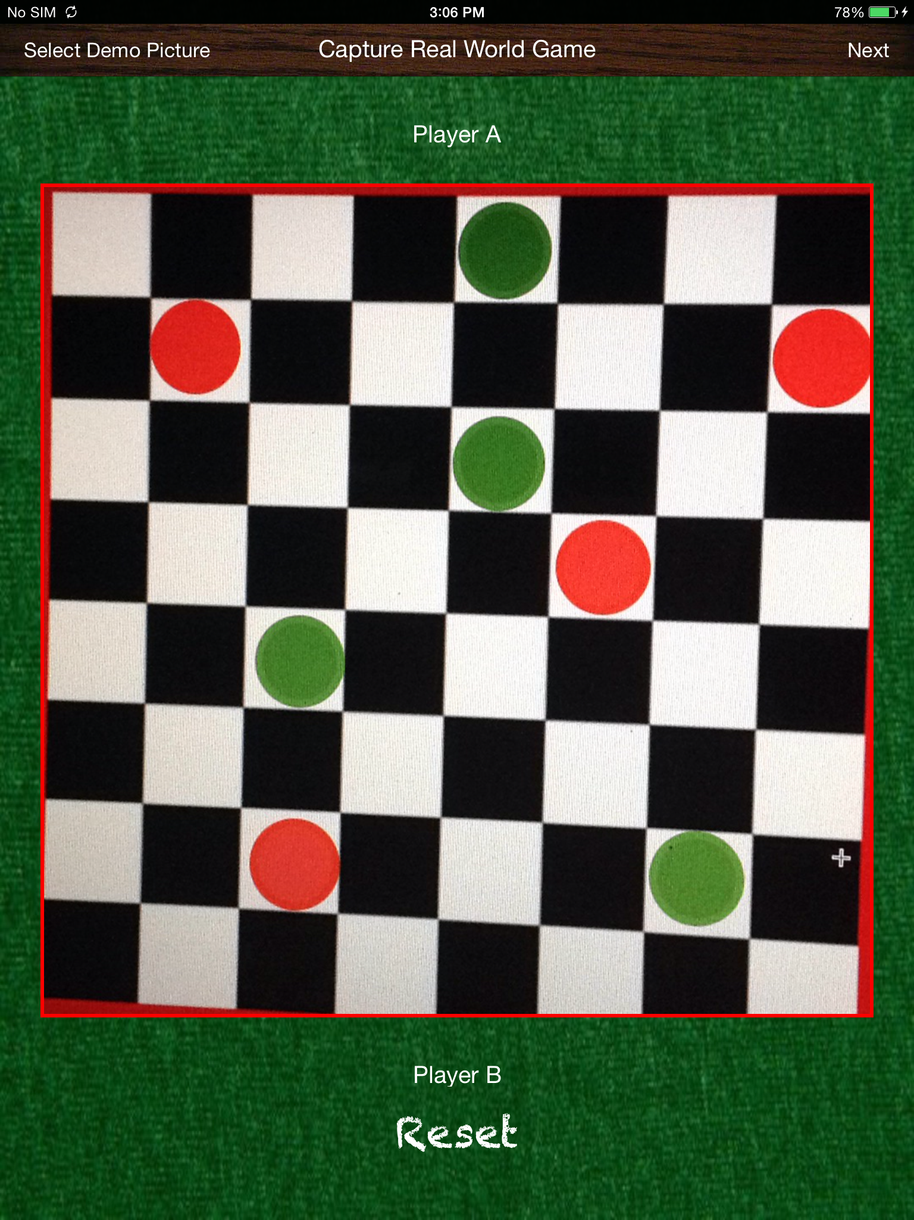

Slide 8
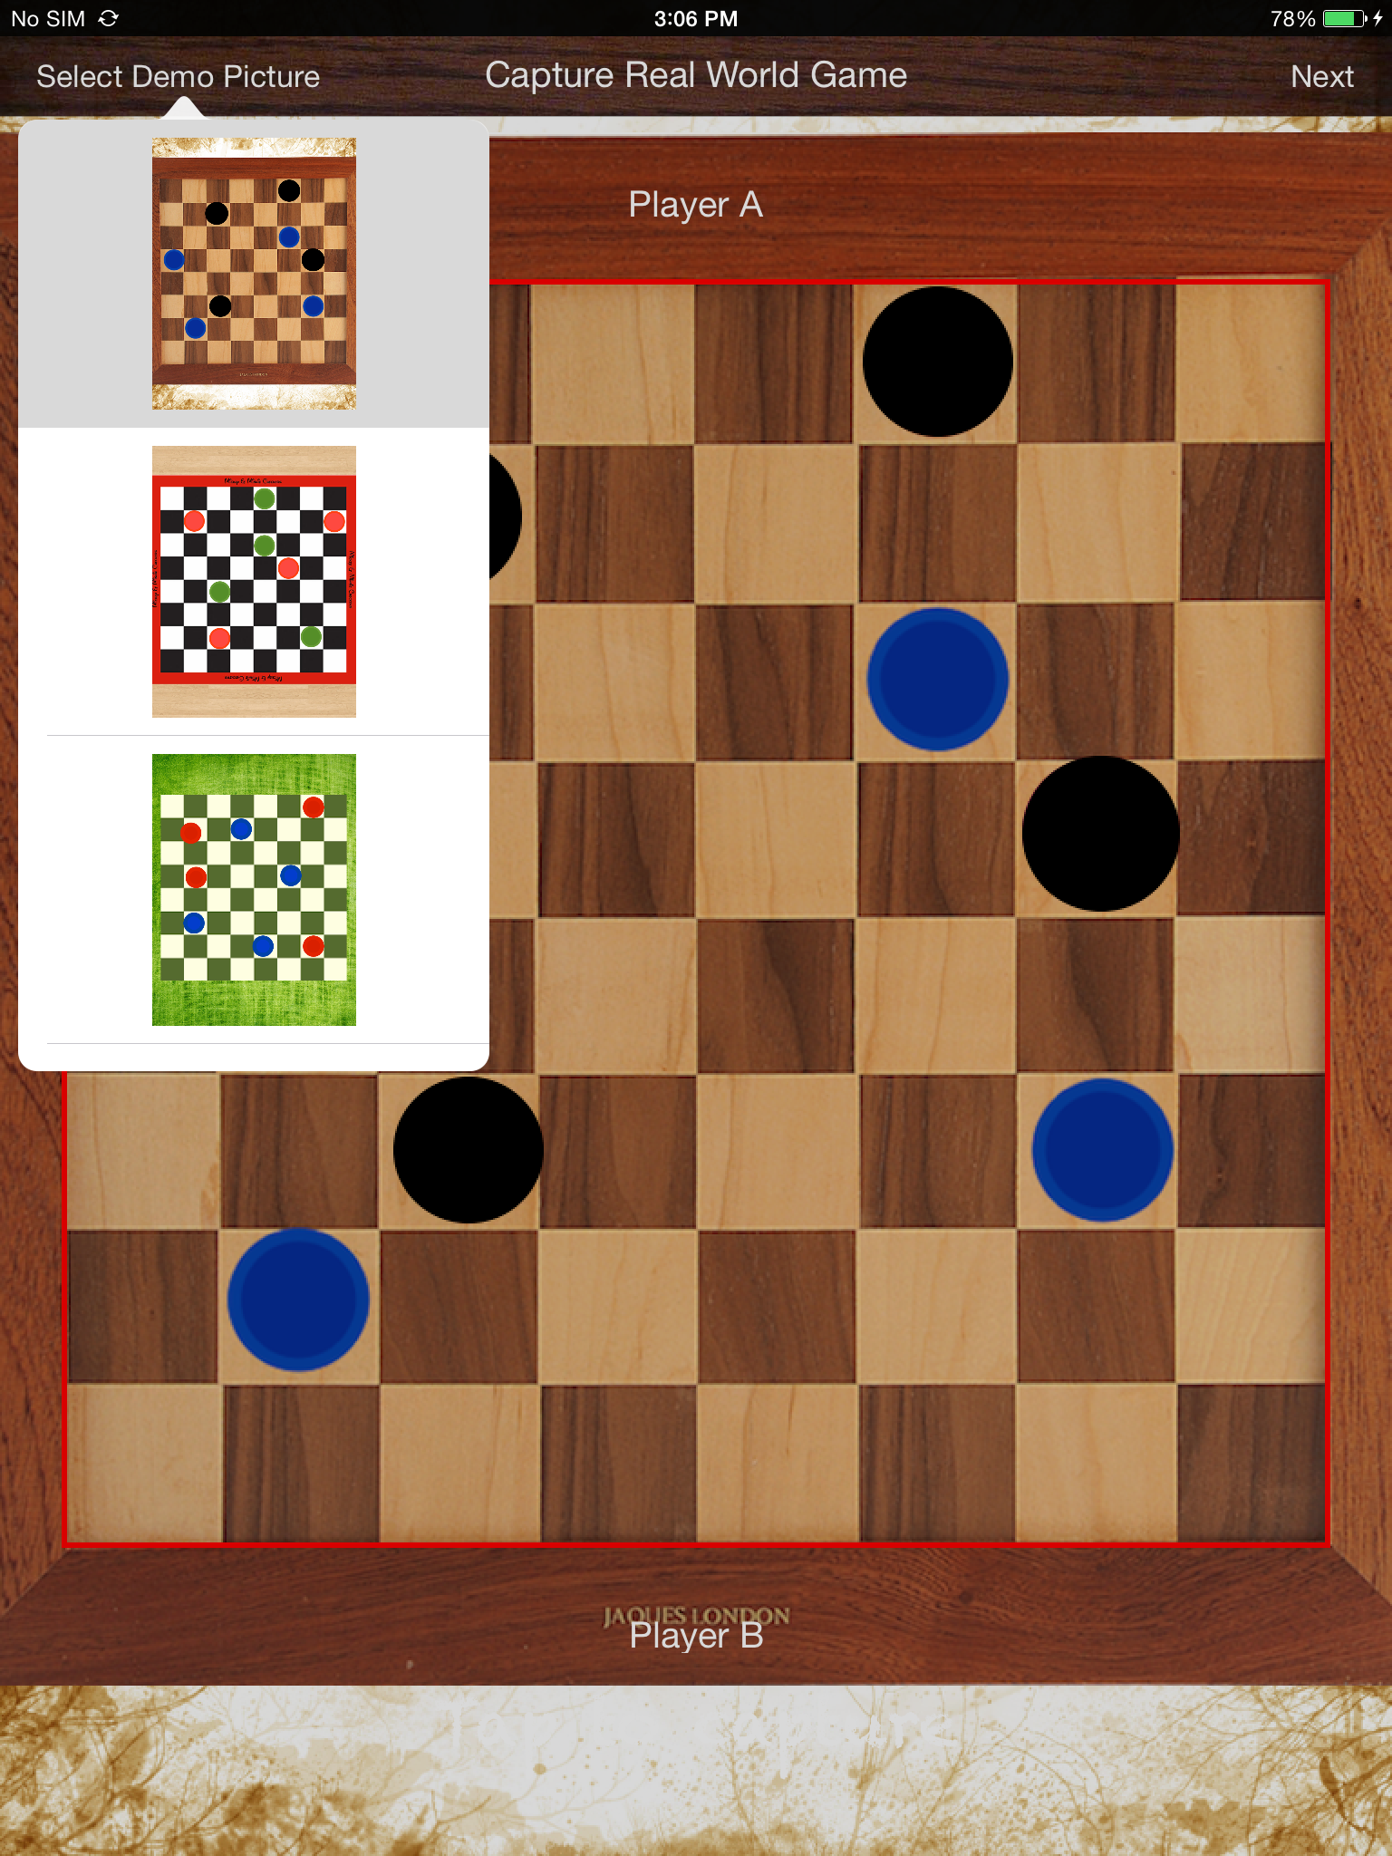

Slide 9
Screens
Screen 2 – Game Screen
The captured image is passed to this screen. We detect the colors for each check and draw them to present the board.
Using Image Processing techniques, we detect the coins within each check. Find out the color of each coin and draw them with their actual colors.
The coins can be moved across to proceed with game play. Due to time constraints we have implemented the only diagonal coin movement for demonstration purpose. The actual game logic is not added.

Slide 10
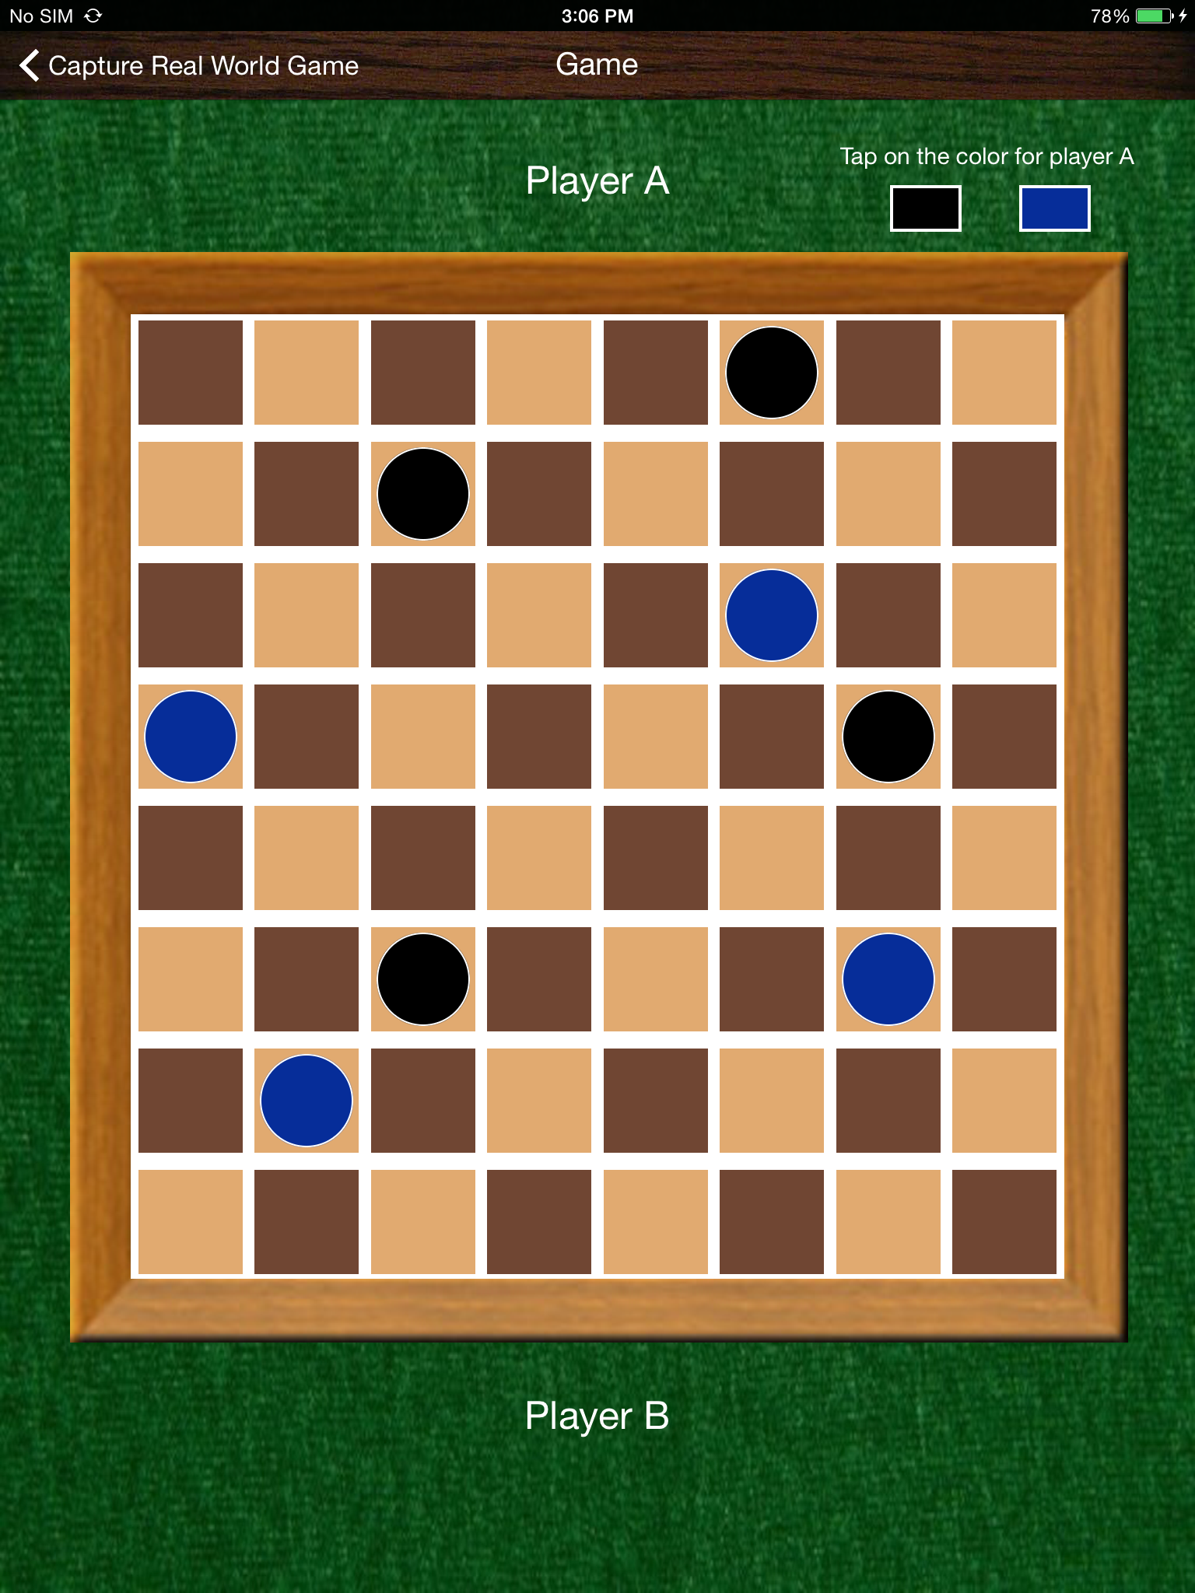

Slide 11
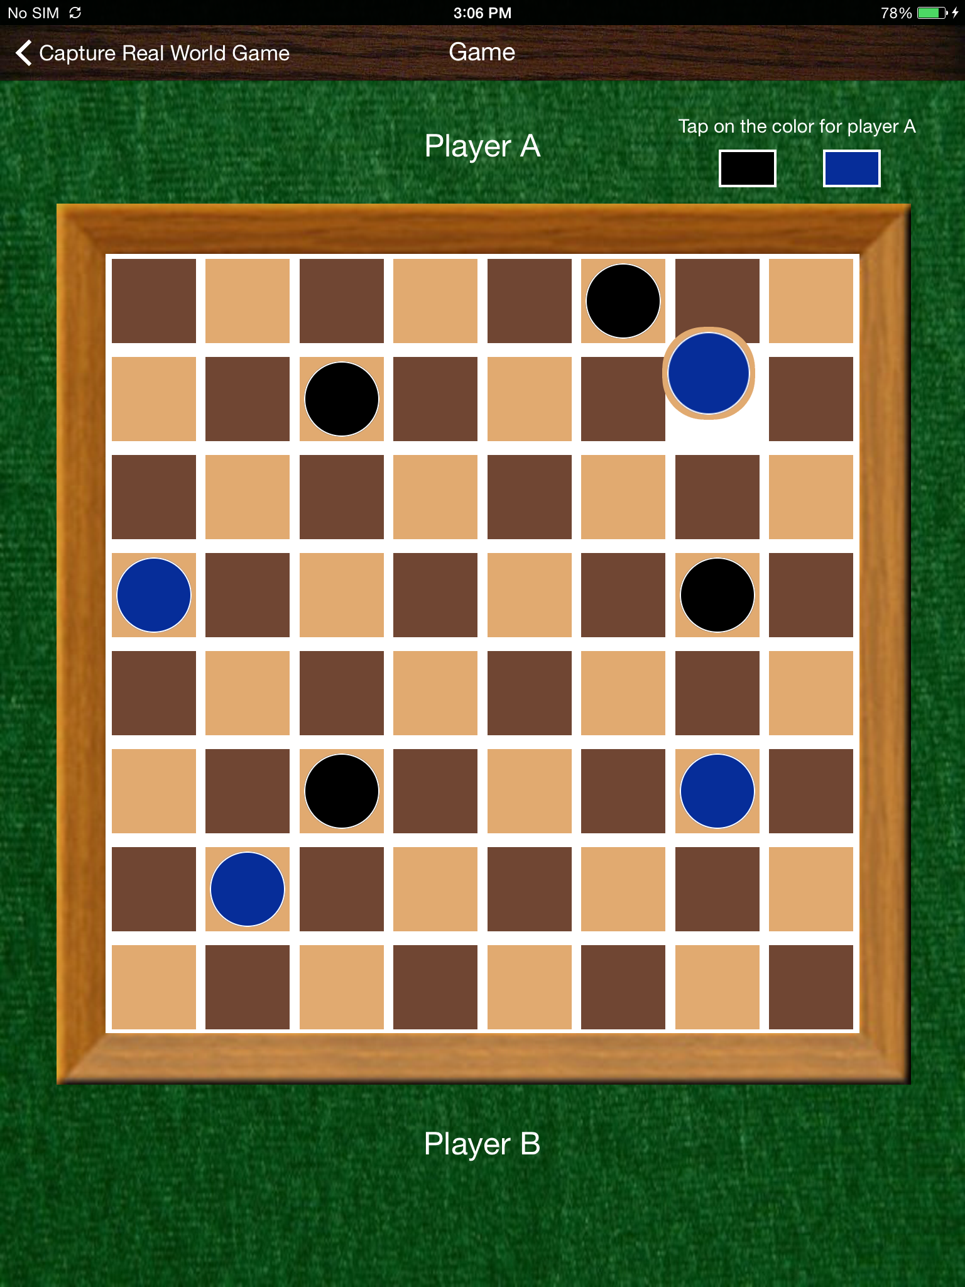

Slide 12
Tools and Frameworks
Xcode 6.2
Core Graphics and OpenCV Framework for image processing

Slide 13
References

Slide 14
Future Improvement
Completing the game logic to enable user to actually proceed with game play.
Improving the board and coin detection algorithms to make them work for noisy images and complex images.
Detecting the different shaped coins instead of only circular ones.

Slide 15
Thank You!

